Slide 1
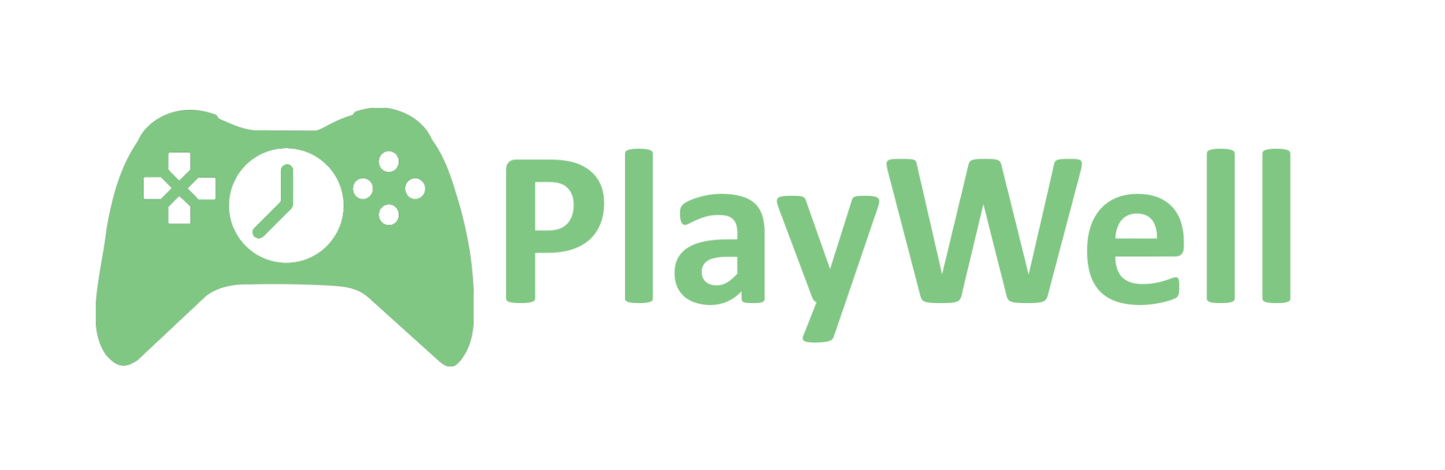
Group 7:
Sepehr, Anthony, Patrick, Fonse
Notes:
Patrick
Hey everyone we are group 7, welcome to the final presentation for our app, Playwell!

Slide 2

Build better gaming habits through tracking and limiting the time you spend on gaming.
Notes:
Patrick
Here’s a quick reintroduction to our app: PlayWell aims to help gamers build better gaming habits by tracking and helping to limit the time you spend on gaming.

Slide 3



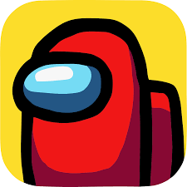


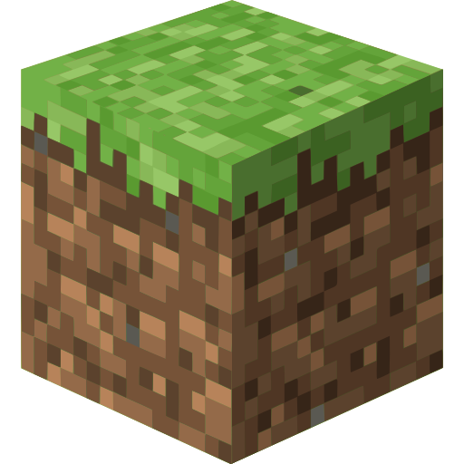





Key Features
View overall playtime at a glance
View playtime for individual games
Daily playtime limits
Playtime history
Notes:
Patrick
Our key features to help accomplish our goal are:
Being able to view your overall playtime at a glance
Being able to view your playtime for individual games
Being able to set playtime limits per day that only count down when you play a game
And being able to see your overall playtime history
With these features, gamers can monitor how much they play, both per day and over a long period of time, helping them see and a manage their habits.
Now I’ll pass it to Fonse to demo our app

Slide 4
Demo
Notes:
Fonse
Open app to the home page and show big number
Go to limits, and set a timer for today 1 minute after the big number
Open the game, go back to the home page and show the game being detected
Go to limits show the timer ticking down
Go to the system tray and show that off, then click Open App
Go to stats page and show each chart 1 by 1
Go to history page and show each graph 1 by 1
Go to settings page and do brief overview of settings
Once the game limit has been hit, show exit button

Slide 5
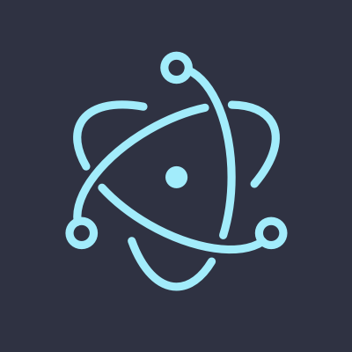




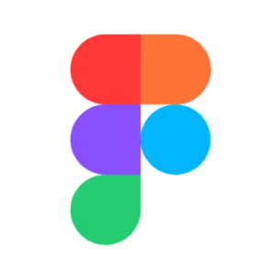
Technology Stack
 |  | Technology | Why We Chose It
Framework |  | Electron | Enables desktop app with system tray + background process
Frontend |  | React (inside Electron) | Modern, component-based, fast dev cycle
Backend |  | Node.js (Electron background process), WMIC | Works seamlessly with Electron main process
Database |  | SQLite + Prisma ORM | Reliable, relational, easy schema management, lightweight
Tools |  | Vite, npm, GitHub | Fast builds, team collaboration, dependency mgmt
Design Resources |  | Figma (Wireframe), Figjam (Whiteboarding), Lucidchart (ERD) | Easy to use for collaborative design
Notes:
SEPEHR
For our tech stack
our main priority is having an app that is lightweight, and would have the functionality we needed.
We wanted our app to still feel like a web app
even though it is still a desktop app, which is why we are using Electron
because we can design our frontend intuitively using React
and use Node.js libraries for backend functionality
Electron also allows us to have our app available on the system tray which we’ll see later during the demo
For our database we are using a SQL database.
We wanted to challenge ourselves with using newer technology.
And we felt that SQL would be simpler especially for keeping the Gaming Sessions in our database.
Our app is currently using PostgreSQL but we are using Prisma ORM to interact with Postgres from our backend, so we don’t have to manually create SQL statements when we are coding
We also use GitHub for workflow and collaboration.
Finally, we use apps like Figma, Figjam and Lucidchart for diagrams and wireframes

Slide 6
Architecture Highlights
Electron Multi-Process Separated Main (system integration) and Renderer (UI) for security and performance
Background Service Pattern Independent workers (GameTracker, FocusTracker, TimerController) running on intervals
Event-Driven Coordination Services communicate via EventEmitter patterns (e.g., gaming-state-changed)
Secure IPC Bridge Preload script exposes limited, secure API to renderer (no direct Node.js access)
Repository Pattern Clean separation between business logic and data access
Notes:
SEPEHR

Slide 7
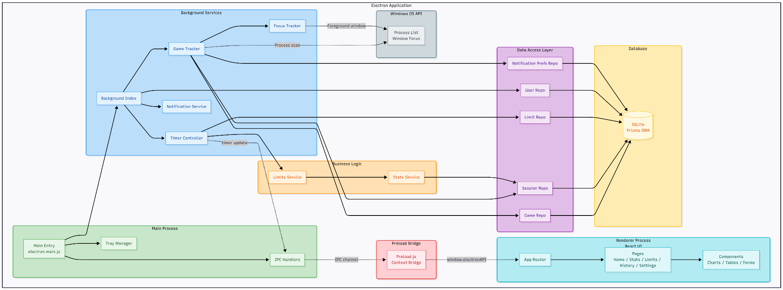
Notes:
SEPEHR

Slide 8
Final Product vs Initial Vision
Added Beyond original vision:
Focus tracking system (30s grace period for window switches)
Additional notifications (new game, start/stop alerts, user preferences)
Game enable/disable toggle (selective tracking)
Changed from original vision:
PostgreSQL → SQLite (better fit for the project)
Removed genre field (auto-detection too complex)
Cut Features:
AI integration (scope)
Cross-OS integration
Notes:
Anthony
Some of the features we integrated were beyond our original vision for the project. These include:
A focus tracking system that allows for unfocused games to not be tracked by our system (ex. Alt-Tabbing to look at wikis, take a break, etc.)
Additional notifications (Finding a new game, starting / stopping a game, users can opt into these notifications based on their preferences)
Game enable / disable toggle (can choose to track / untrack certain games)
Changes from the original vision include:
Changing databases from PostgreSQL to SQLite as it was a better fit for our project
Removing the genre of games from being tracked due to the auto-detection being too complex
Cut features include:
AI Integration (scope to include this feature was too large)
Cross-OS Integration (Application only works on Windows)

Slide 9
Challenges
Specialized roles Splitting work between front end and back end made integration harder at times.
Database switch We moved from PostgreSQL to SQLite, which required extra time to adjust our codebase.
Game detection There are many possible games to track. We built a simple pattern based system for major install folders and let users add any custom titles.
Scheduling Coordinating meeting times was difficult because of different schedules.
Notes:
Anthony
Each member had their own specialized roles, splitting our team to a frontend and backend group. This made integrating new features harder at times due to both groups having to work on the features without creating merge conflicts
Again, we moved from PostgreSQL to SQLite as it was a better fit, and this took some additional time to adjust our codebase to integrate the new database, pulling us away from working on the functionality of the application
There were also many games to track from different services (Steam, Epic, Standalone, etc.). This required us to have a simple pattern based system for major install folders and add the functionality to let users add their own games
Finally, coordinating meeting times was difficult because of our different schedules (half of the team are in netsec, while the other half are in game dev)

Slide 10
Lessons Learned
Trying New Tools We intentionally used technologies that were new to some teammates. Learning Electron and React added challenge but paid off in experience.
Keep It Simple We considered advanced game detection ideas like AI or external APIs. A simple heuristic worked well and we let users add uncommon games themselves.
Use the Right Database We began with PostgreSQL for flexibility. For a local app, SQLite was faster, lighter and a better fit.
Notes:
Patrick
Thank Anthony. Here are the key takeaways from the project for our team:
We wanted to try new technologies, namely Electron. Some of our team members had also never used React before either, so learning these added some additional challenge, but ultimately it was a rewarding learning experience
We also learned we should try to keep things simpler; we considered using some more complicated methods for game detection, but quickly found that a simpler solution worked better and was easier to do. After all, a simple solution that works is better than a complex one that doesn’t.
As mentioned earlier, we also switched databases from PostgreSQL to SQLite. We spent extra time on the migration when it would’ve been better to pick the right databas from the start. Since our app is local we found that SQLite was overall a better fit for our project than Postgres was.

Slide 11
THANK YOU
Notes:
Patrick
That’s all for us, thank you for listening to our presentation!

